Slide 1
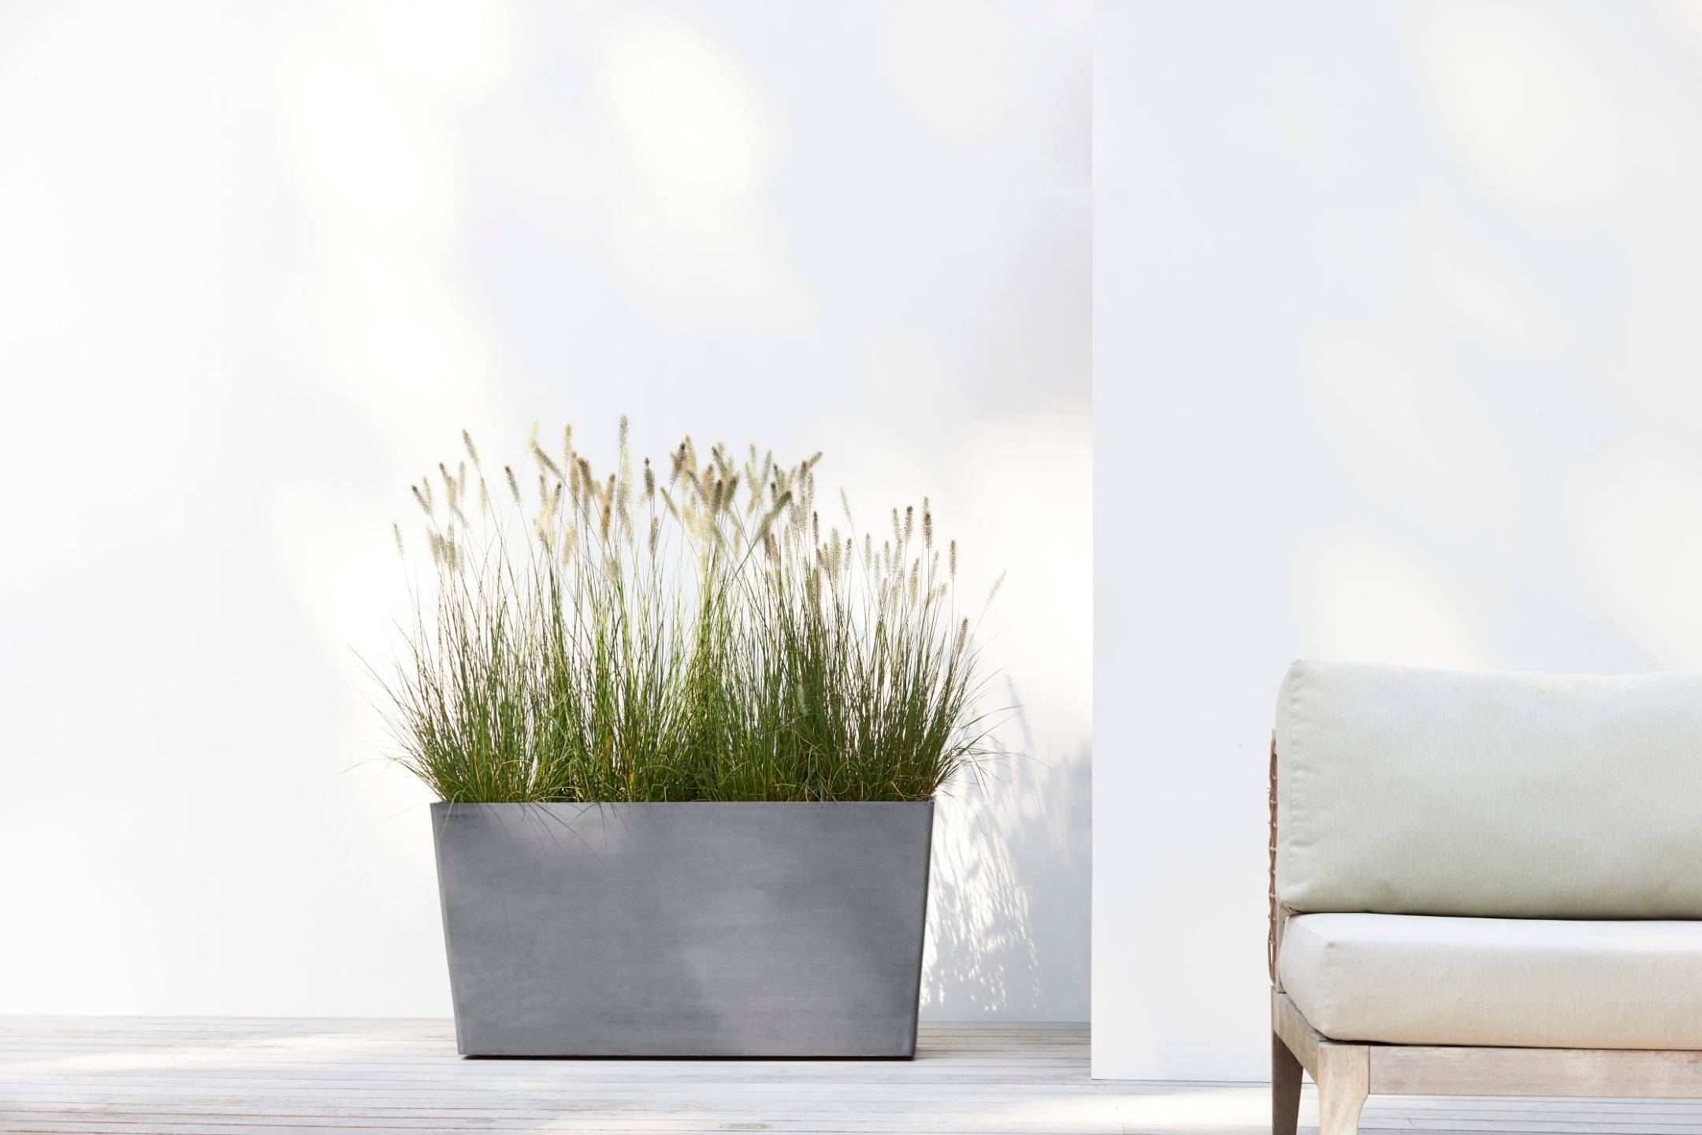


Slide 2
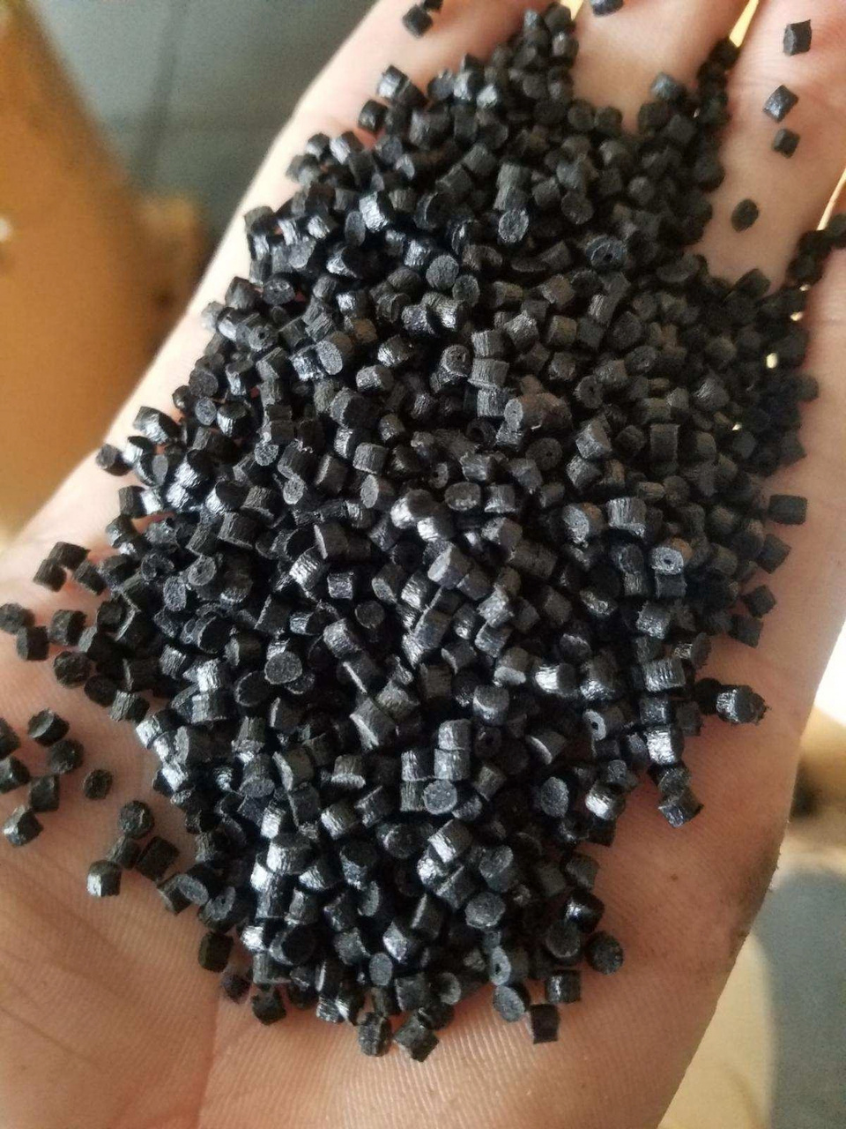

Made from recycled materials
80% 17% 3%
recycled plastic
for impact resistance
recycled natural minerals
for the look and feel of stone
natural mineral pigments
for colour that runs all the way through

Slide 3
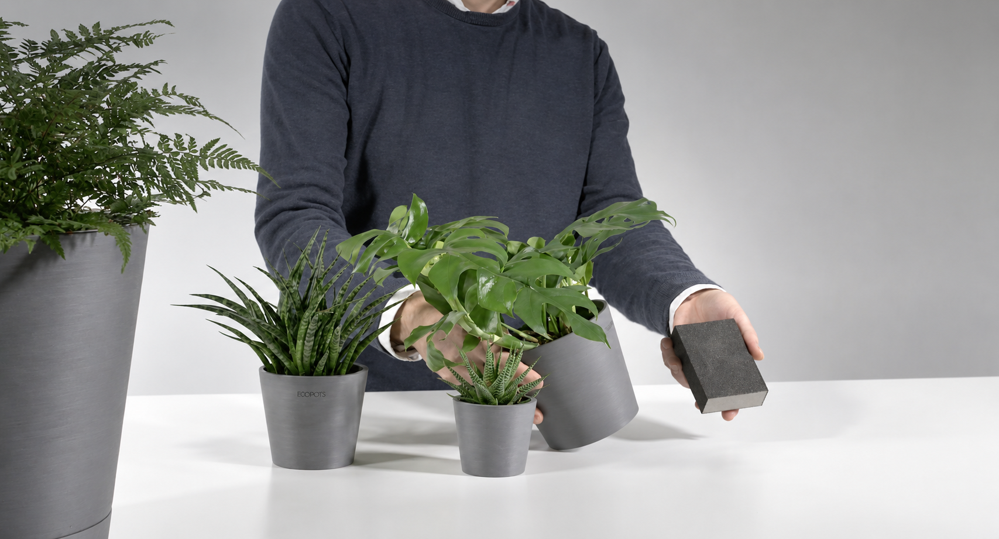
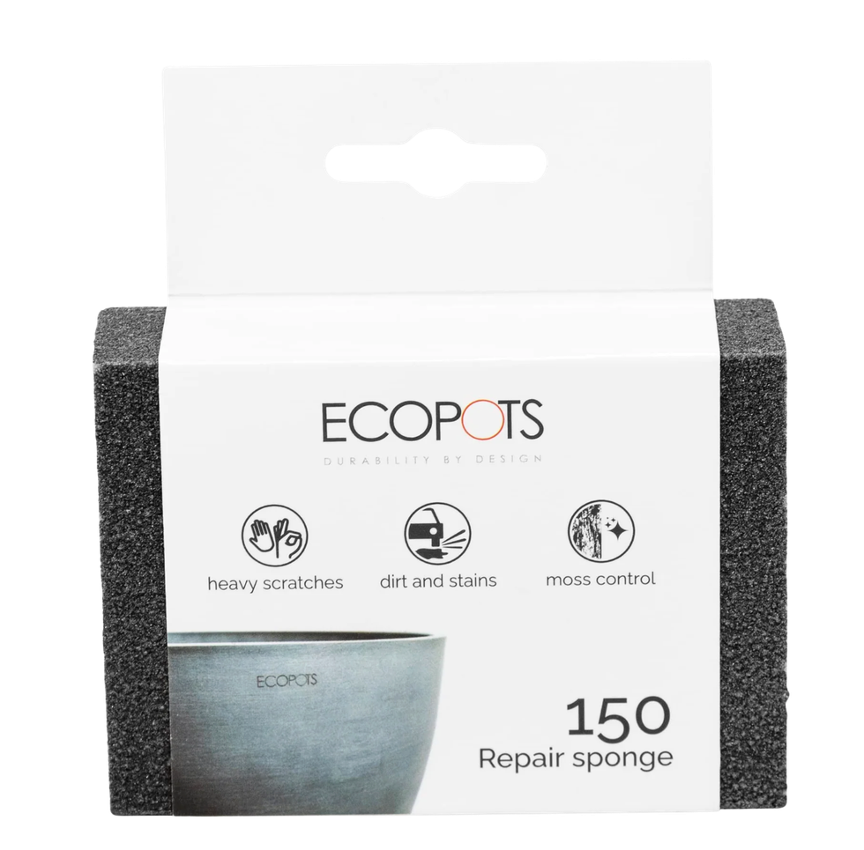

The only pot you can repair

Slide 4
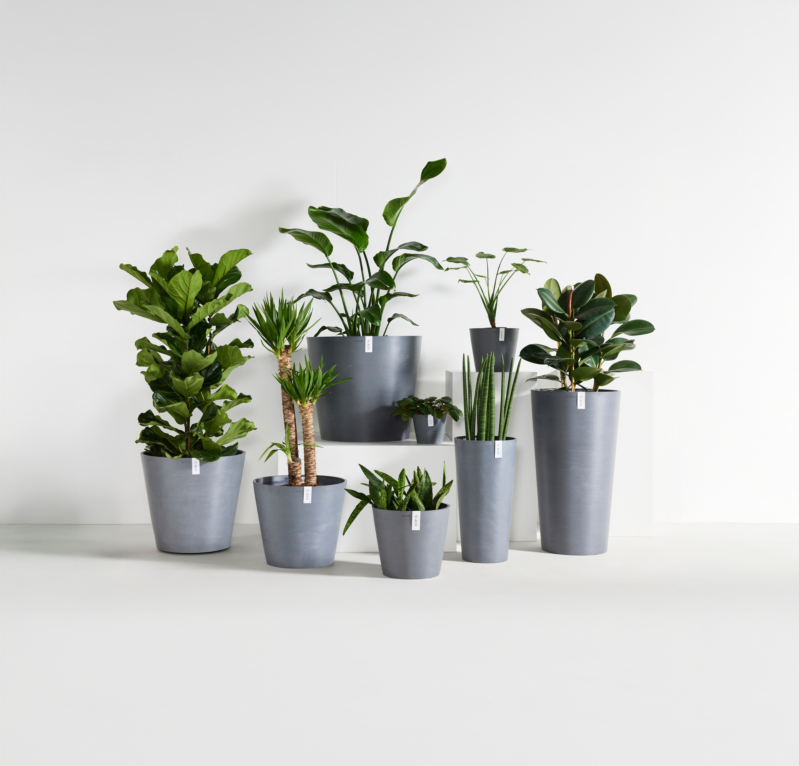
THE COLLECTION
Amsterdam

Slide 5
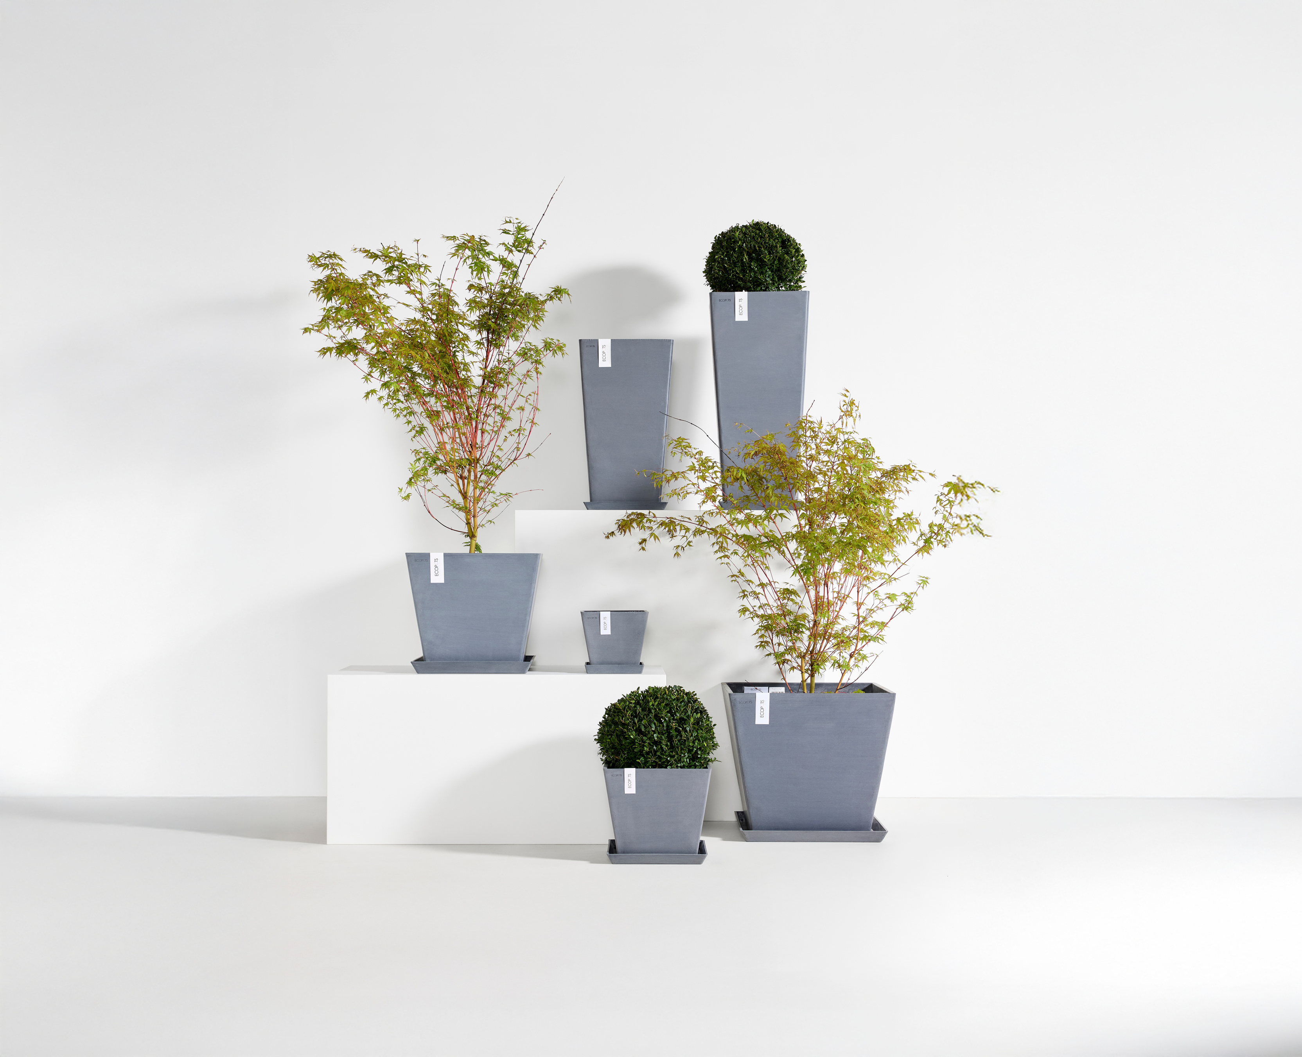
THE COLLECTION
Rotterdam

Slide 6
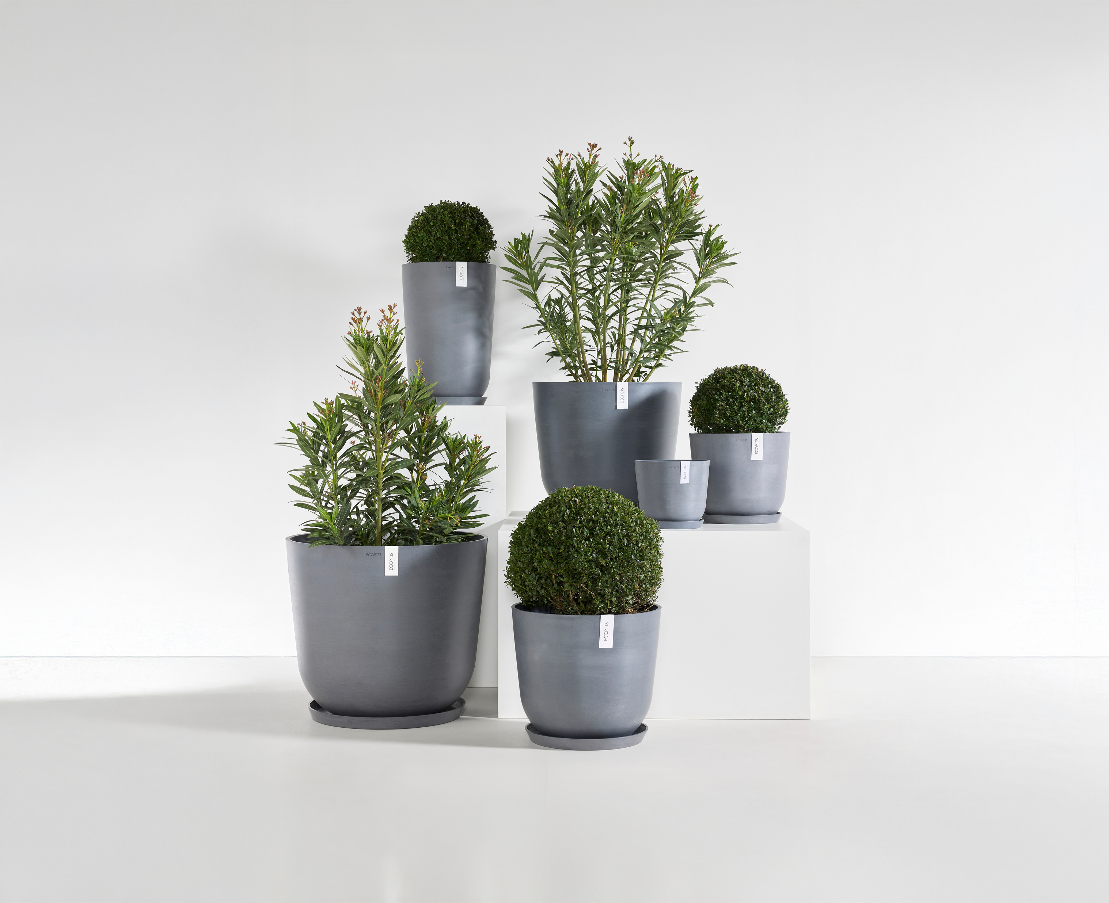
THE COLLECTION
Oslo

Slide 7
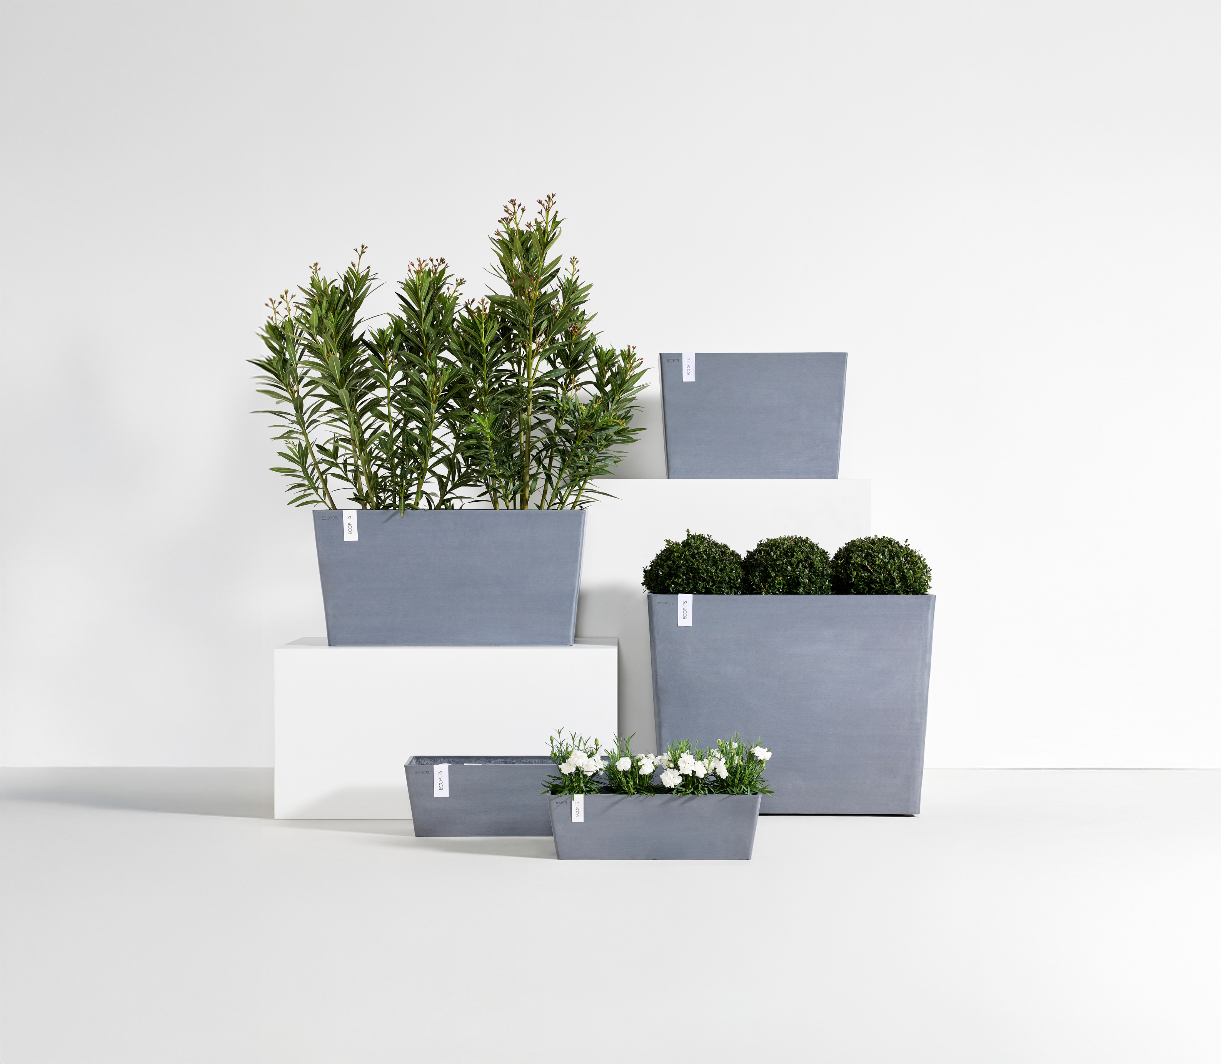
THE COLLECTION
Paris

Slide 8
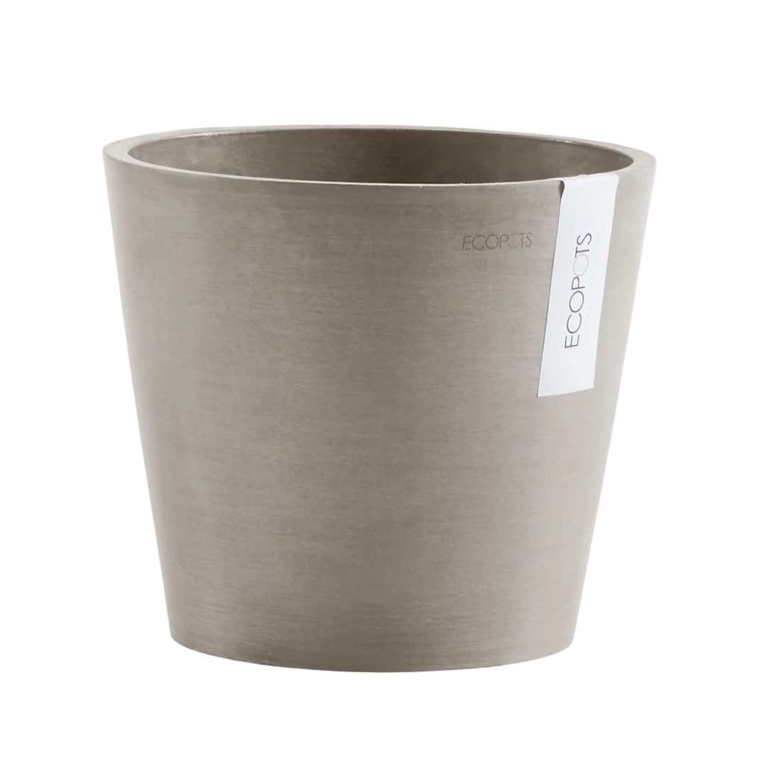
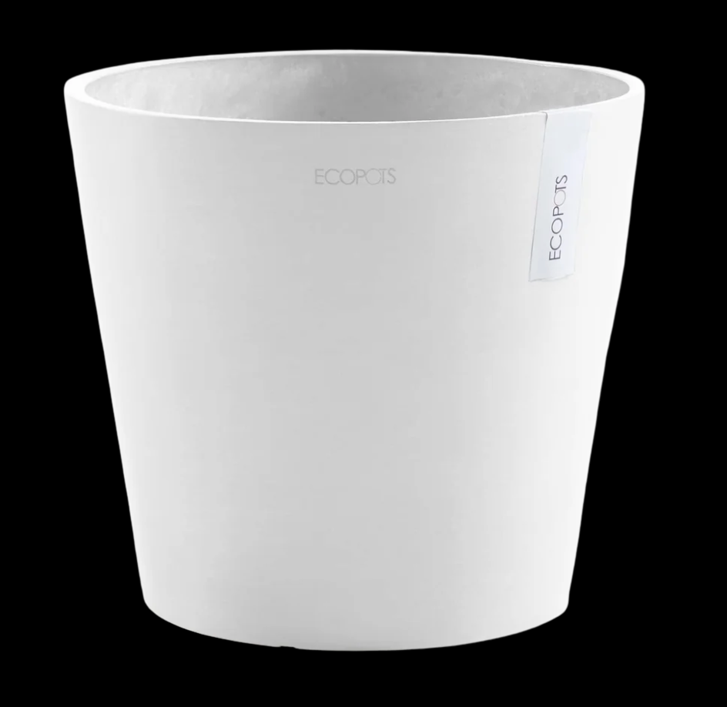
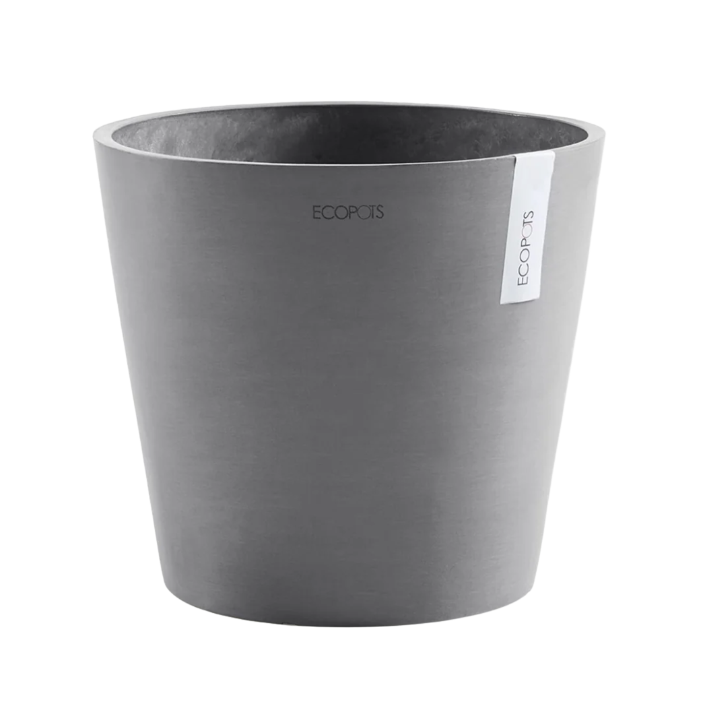
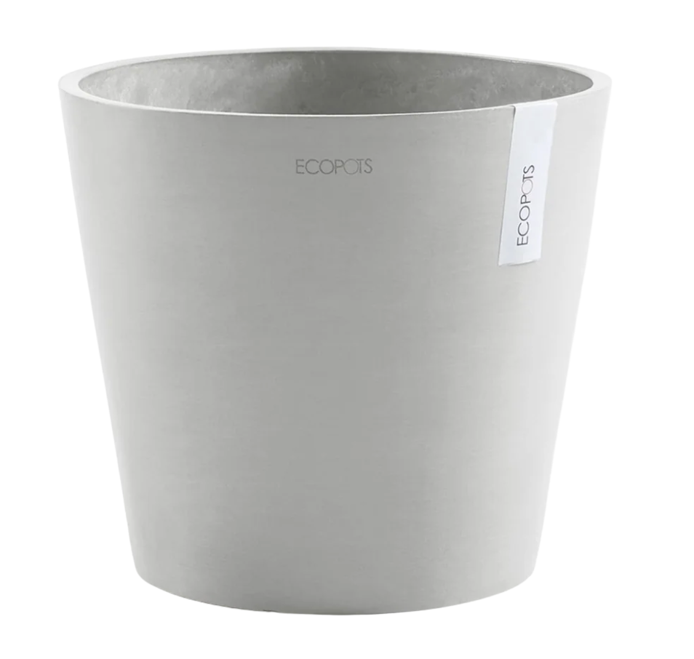
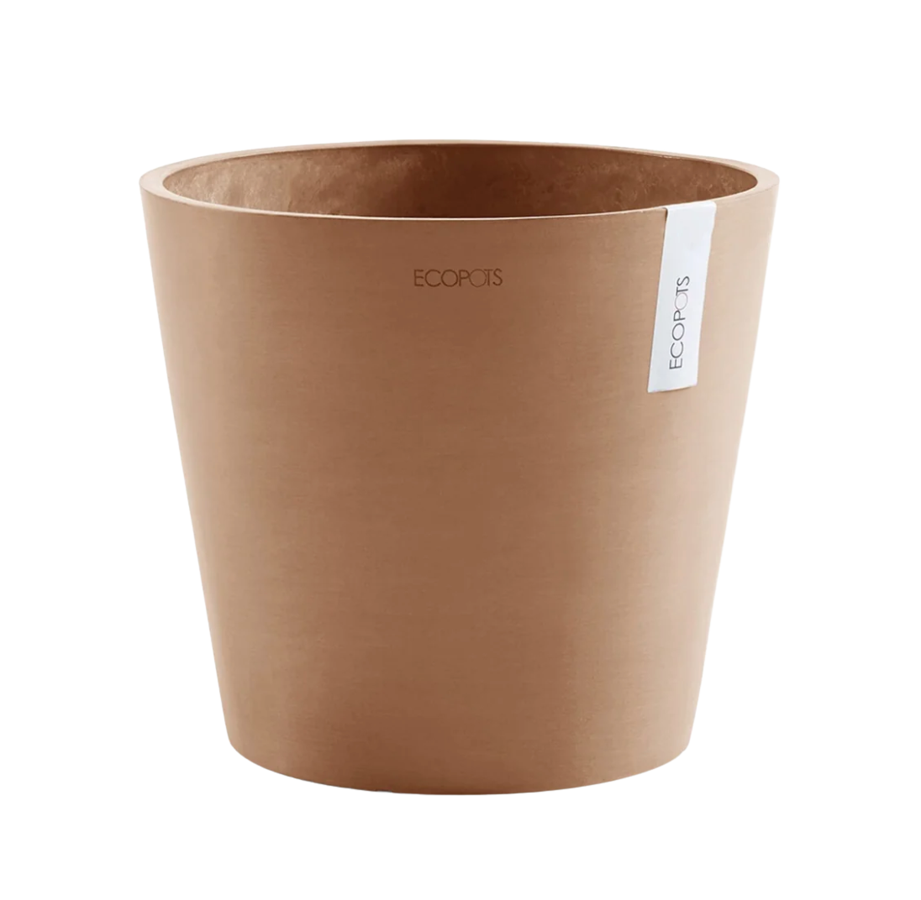
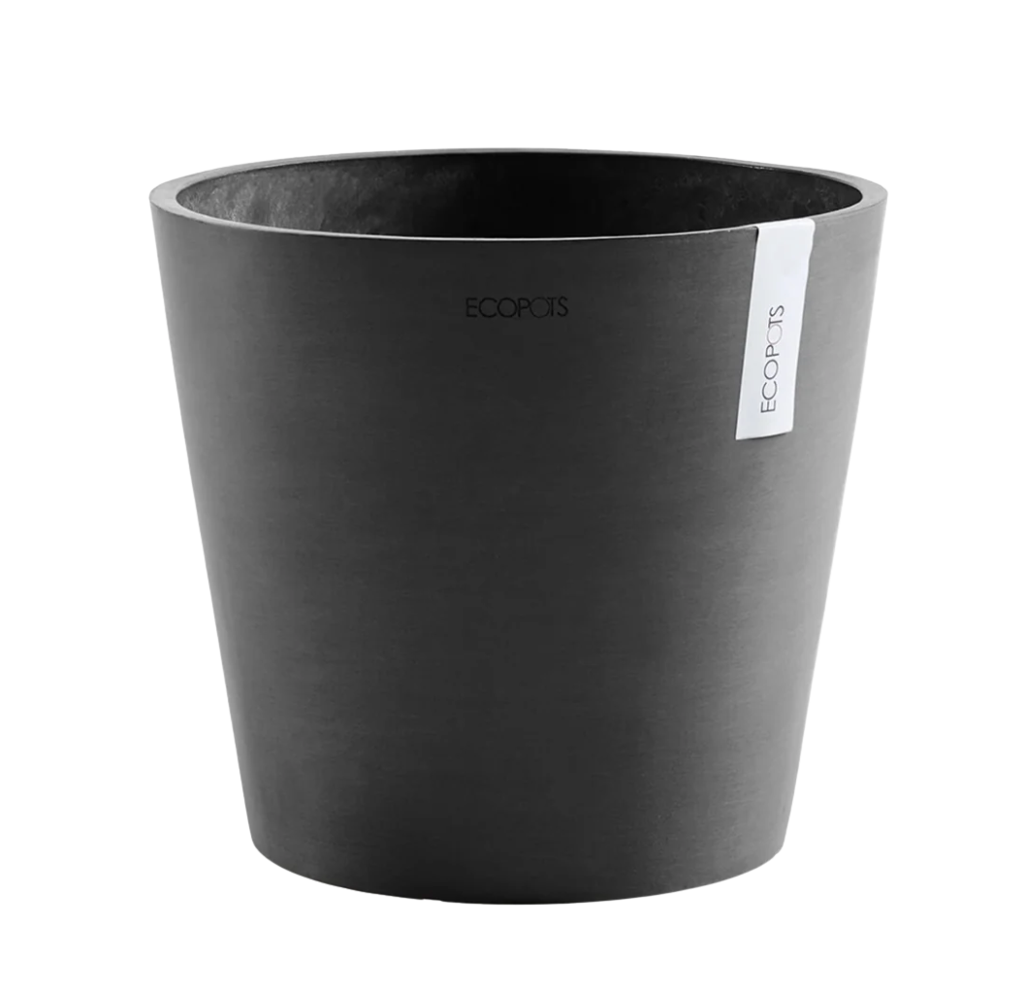
Timeless colour & texture
Six natural colours, all with a hand-finished texture that can be renewed again and again.

Slide 9







Certified for expert sustainability standards

Slide 10
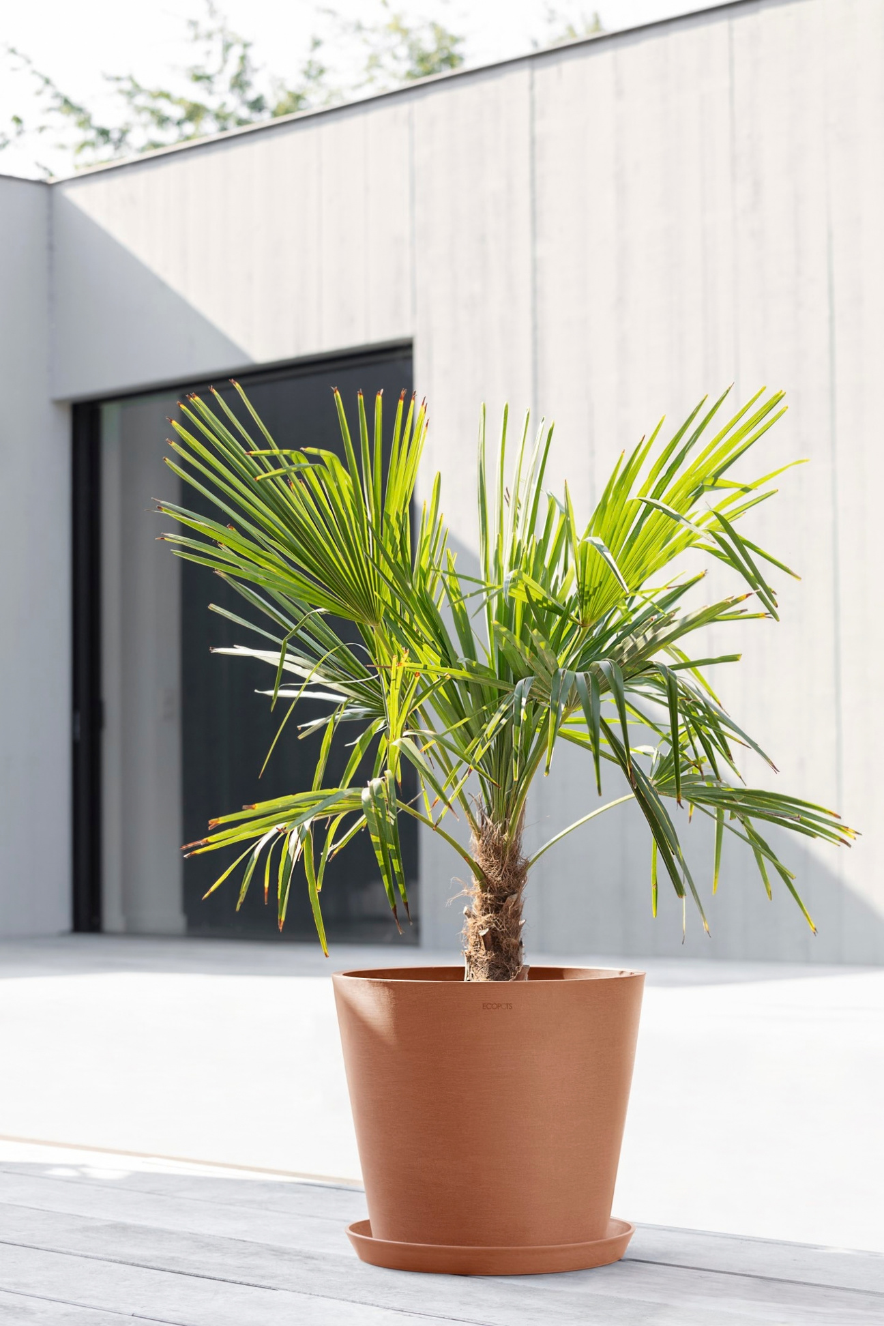

Ecopots is a brand of
www.ecopots.com

